Slide 1
CHI-DMA
Only Aligned Addresses Version

Slide 2
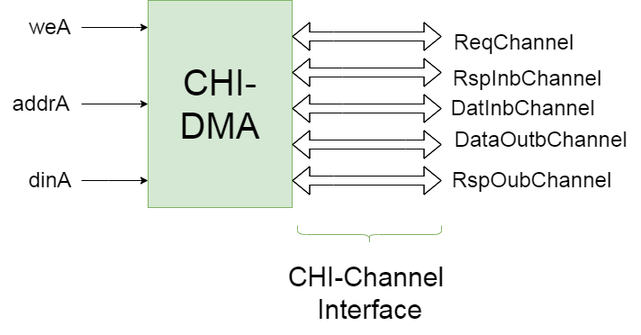
DMA

Slide 3
Pseudo CPU
Module that inserts Transfers in DMA :
Inputs:
PhaseIn : Determines the operation mode of CPU
NewPhase: Valid for PhaseIn ( changes the phase)
BRAMData: Read Data from BRAM’s Descriptor
Outputs:
weA : WE for port A of BRAM
addrA: Address of Descriptor in BRAM
dinA : Data to be written in BRAM

Slide 4
Pseudo CPU
Phases :
Insert a small Transfer in DMA (one CHI-Read and Write)
Insert a large Transfer in DMA (many CHI-Reads and Writes)
Insert many(250) small Transfers (one CHI-Read and Write each)
Insert many large (15) Transfers
Insert a random combination of Large and small Transfers in DMA with a random time delay between insertions
Insert in DMA a lot of(450) completely random size Transfers in random Desc Addresses with random insertion delay

Slide 5
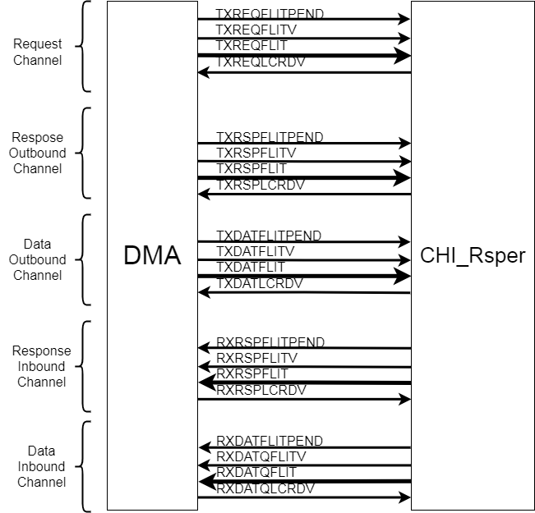
CHI-Responser
Module that responds to every CHI-Request of DMA.
Inputs-Outputs : only CHI-Channels
(CHI-Channel : FLITPEND,FLITV,FLIT,LCRDV)
CHI-Responser answers every CHI Request 11 cycles after the request received and there are enough Crds. Also it gives infinite Crds to DMA

Slide 6
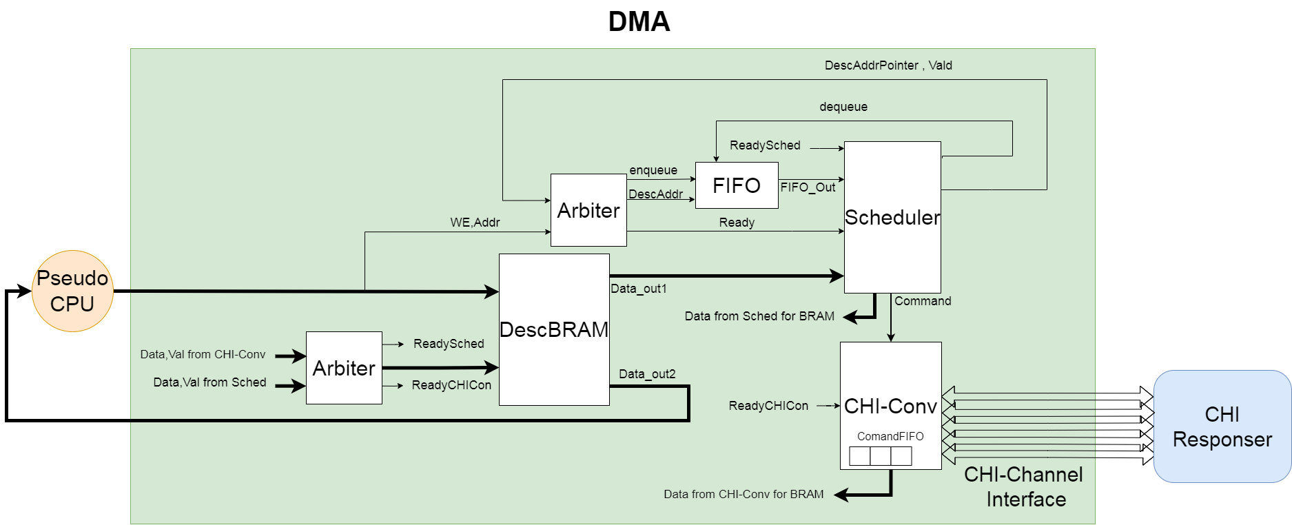
FULL System

Slide 7
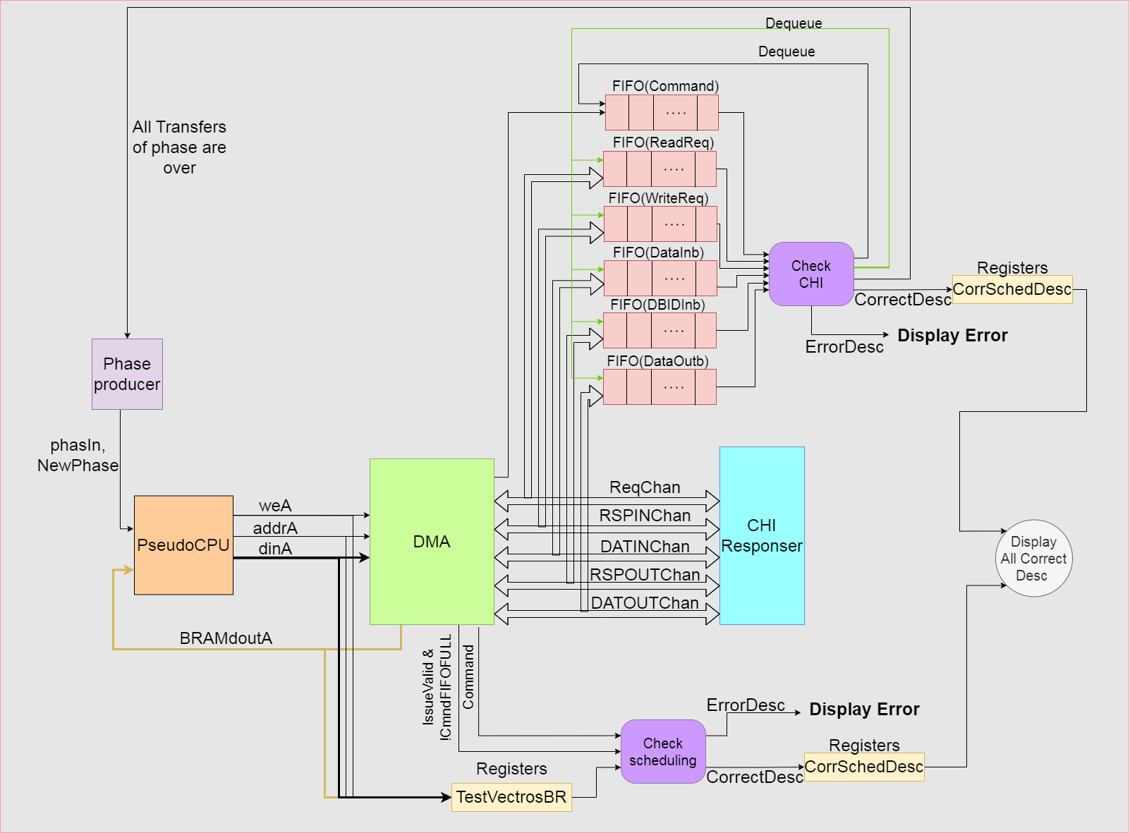
Test Full System

Slide 8
Test Full System
The testing of the full system is divided into 2 parts :
1st part : store every Transfer is inserted in a TestVectorBRAM and every time a command is scheduled check if its fields are correct based to the corresponding inserted Transfer.
2nd part : enqueue in FIFOs every scheduled command and CHI-transaction which sent on any channel and when all FIFOs are non-Empty check if the first element of every FIFO satisfies the appropriate requirements of CHI and transactions are correct based to the command .

Slide 9
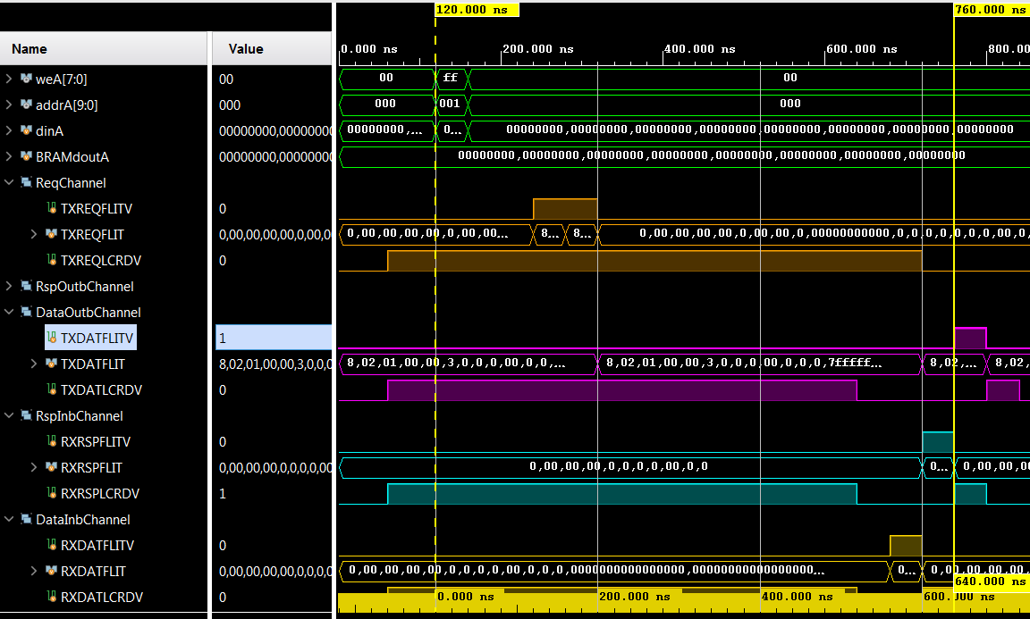
Results: Phase 1
Clk : 40 ns
Latency : 640 ns

Slide 10
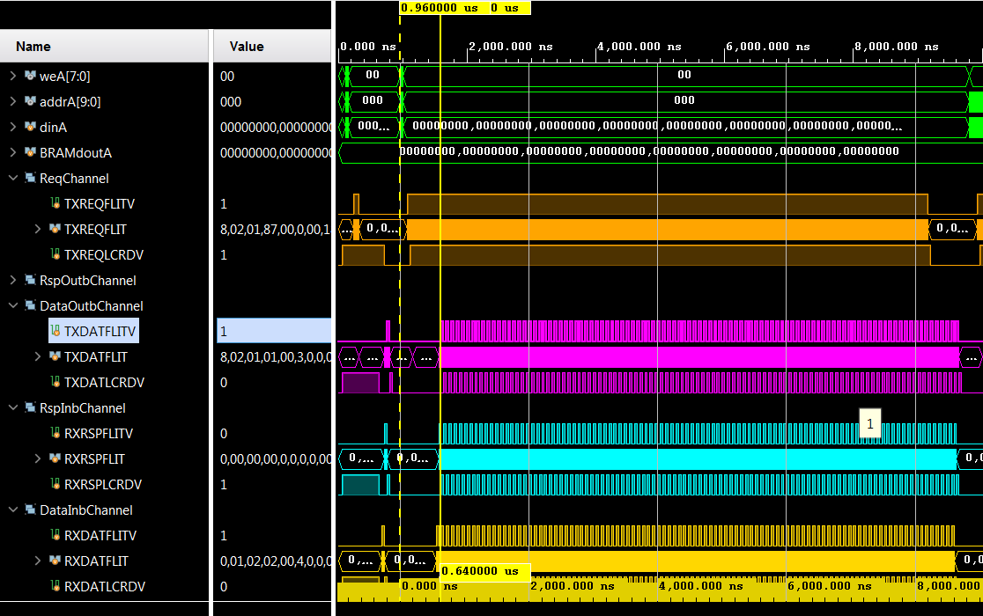
Results: Phase 2
Latency for first transaction: 640 ns(same)
Throughput: max because Requesting every cycle 512 bit/2cycles = 512/(40*2) = 6.4 bit/ns =6400000000bit/s =745 MB/s

Slide 11
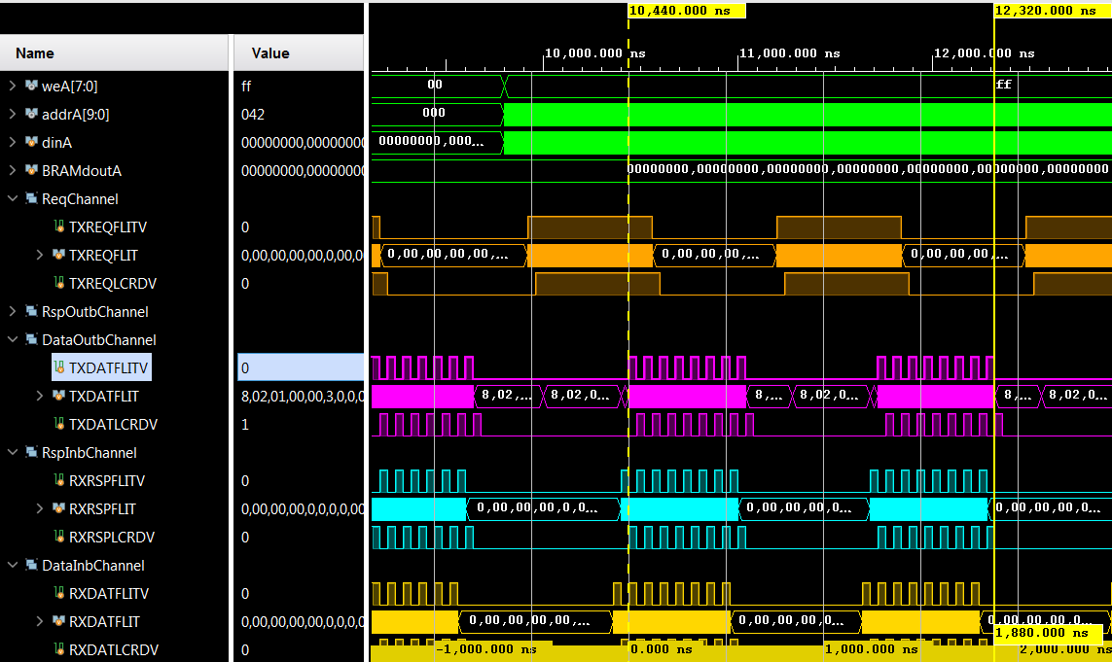
Results: Phase 3
Throughput here is not max because there are many small transfers and scheduler cant schedule a full chunk. Also Completer stops Scheduler from Reading BRAM to update the status and for this reason CHI–Converter has not enough commands to Request on every cycle . Throughput is : 16*512/1880 bit/ns = 4.34bit/ns = 550 MB/s

Slide 12
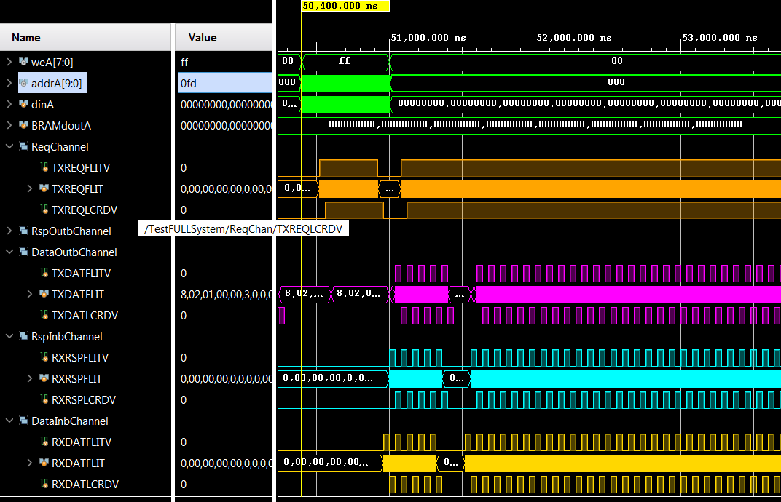
Results: Phase 4
Throughput is again max in this phase because the inserted transfers are Large. The small gap that happens at the start of the phase is due to the continuous insertions of Transfers in DMA by CPU which is not allow scheduler to Read BRAM for a long time

Slide 13
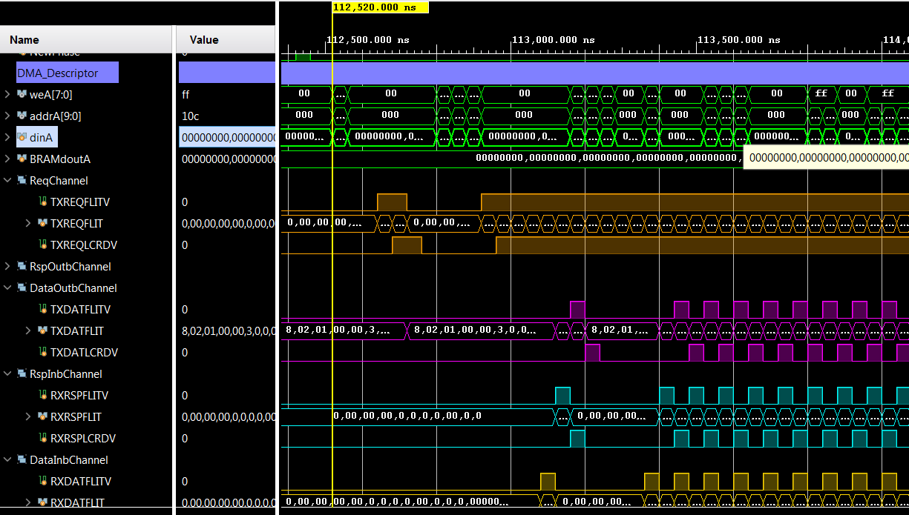
Results : Phase 5
This phase the system has again full throughput. In this phase the inserted Transfers are random. For this reason happens the first Transfer to be a small one which is finished very fast and for this reason there is a small gap at the start of the phase

